Slide 1
Algorithm Analysis and Data Structures
Exercises
Pramote Kuacharoen

Slide 2
Counting Vowels
Write a short Python function that counts the number of vowels in a given character string.

Slide 3
Sum of Squares of Odd Positive Integer
Write a short Python function that takes a positive integer n and returns the sum of the squares of all the odd positive integers smaller than n.

Slide 4
Distinct Numbers in Sequence
Write a Python function that takes a sequence of numbers and determines if all the numbers are different from each other (that is, they are distinct).

Slide 5
Dow Jones Stock Information
Write a program that displays information about a DOW stock
The file format is Company, Symbol, Exchange, Industry, Price at the beginning of the year, Price at the end of the year, Earnings, Dividend
The program
Displays all symbols
Prompts the user for a symbol
Display Company, Industry, Exchange, Growth, Price/Earnings ratio

Slide 6
Thinking Process
Display Symbols
Open file Dow.txt
Read All Content (All line) into list or tuple
Read Symbol from nested list (tuple) => [i][1]
Prompt User Input a Symbol
Display Stock Info
Find Symbol from list => column 2 [i][1]
Calculate and Display
Display Company => column 1 [i][0]
Industry => column 4 [i][3]
Exchange => column 3 [i][2]
Growth => (price end of year - price begin) / price begin * 100 ➔ (col5-col4 / col4)*100
Price/Earnings ratio => col 6 / col7 ➔ [i][5] / [i][6]

Slide 7
Best and Worst Performing Stocks
Write a program that displays the best and the worst performing stocks
Percentage change = (Price at the end – Price at the beginning)/ Price at the beginning * 100

Slide 8
The Dogs of the Dow
Write a program that displays the dogs which have high yields
Yield = Dividend to Price ratio

Slide 9
Small Dogs of the Dow
Small dogs are determined by the price at the end of year.``

Slide 10
Currency Exchange: Part 1
Write a program that
Reads a name of the country
Displays the name of currency and the exchange rate for requested country
File: Exchrate.txt
File format: name of the country, name of currency, exchange rate/USD$

Slide 11
Average Miles per Gallon
Write a program that calculate average miles per gallon of car models
File: Milage.txt
File format: model, gallons per 100 miles

Slide 12
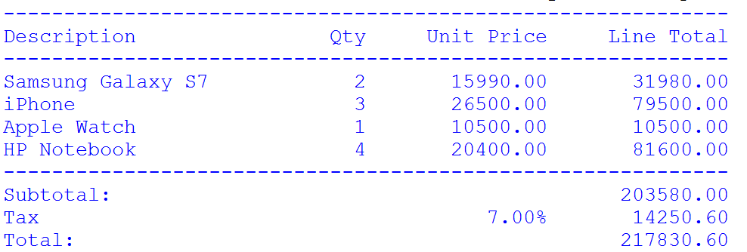
Invoice
Write a program to print an invoice
Write a function called sumproduct which
Accepts a list of description, quantity, price per unit
Returns total amount
Write a function called display_items
Accepts a list of description, quantity, price per unit
Displays description, price per unit, line total
Write a function called display_invoice
Accepts a list of description, quantity, price per unit
Print invoice
File format: description, quantity, price per unit

